Slide 1

Range Sensing Operating System using a Raspberry Pi
Michael Nimdea-Gyan Adu
7041CEM - Embedded Operating Systems
Final Project Presentation

Slide 2
Table of Contents
Introduction
Why Create an Operating System?
Raspberry Pi
Yocto
Kernel Module
Application Module

Slide 3
Introduction
Technology seems to be present in every aspect of daily life
Each device is programmed for a specific task, constricting the scope and cost of developing said device.
Using the Raspberry Pi
Create an Operating System to measure the distance from an Ultrasonic Sensor

Slide 4
Why Create an Operating System?
The Raspberry Pi can be loaded with the default Raspberry Pi OS or any other distribution suitable for the device.
Despite the ease of installing the Raspberry Pi OS, it is bulky and contains various applications that may or may not be used.
Creating a custom operating system allows for a smaller size since only the essential modules and applications are installed.

Slide 5
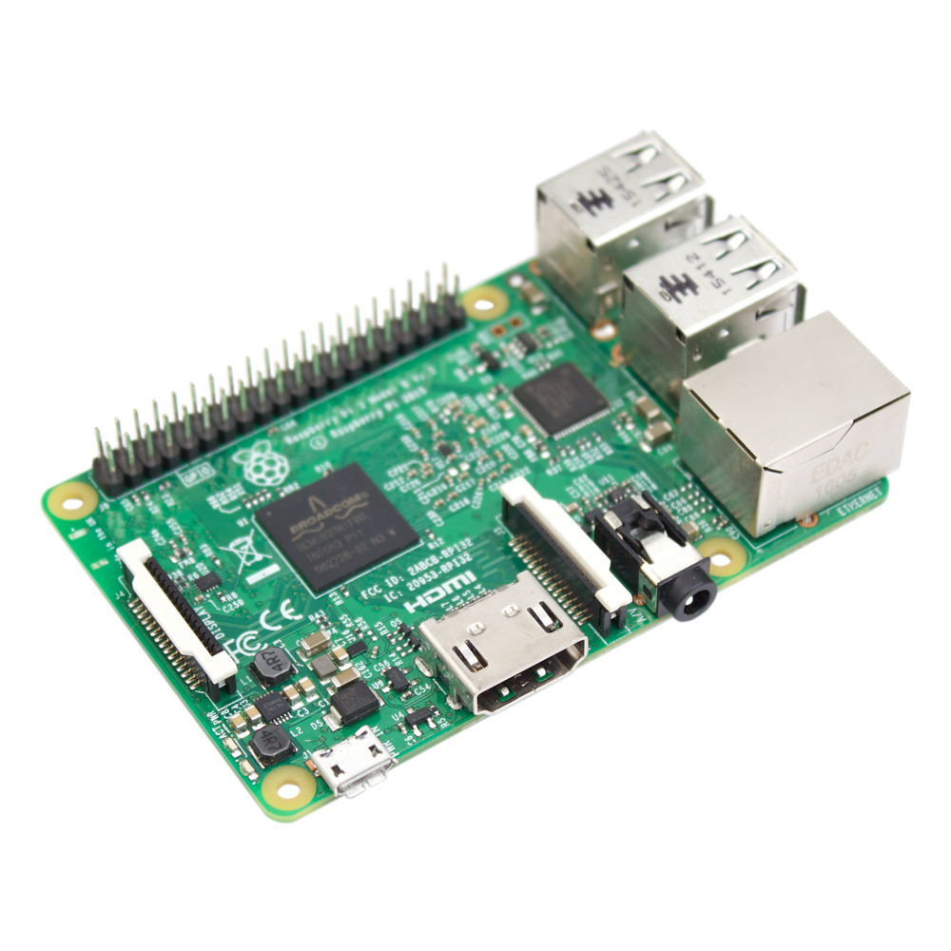
Raspberry Pi
Low-cost, single-board computer (SBC) roughly the size of a credit card.
Mainly used for prototyping and home automation
Linux

Slide 6
Yocto
Using Poky as the reference distribution, a build was created with the meta-openembedded and meta-raspberry layers.
The layers were added using bitbake, and a new layer was created called meta-hcsr04.
This new layer is our custom application layer.
git clone git://git.yoctoproject.org/poky
cd poky
git checkout -b dunfell origin/dunfell
cd ..
git clone git://git.openembedded.org/meta-openembedded -b dunfell
git clone git://git.yoctoproject.org/meta-raspberrypi -b dunfell
source poky/oe-init-build-env project-build-rpi
bitbake-layers add-layer ../meta-raspberrypi
bitbake-layers add-layer ../meta-openembedded/meta-oe
bitbake-layers add-layer ../meta-openembedded/meta-python
bitbake-layers add-layer ../meta-openembedded/meta-networking
bitbake-layers add-layer ../meta-openembedded/meta-multimedia
bitbake-layers show-layers
bitbake-layer create-layer ../meta-hcsr04
bitbake-layer add-layer ../meta-hcsr04

Slide 7
Two recipes were created to fufill the range-sensing function: 1. Kernel Module 2. Application Module

Slide 8
Kernel Module – HCSR04
Global Variables Used
static ktime_t rising, falling; //time variables which hold the time of rising and time of falling for the echo port
struct timespec time; //global time variable used to generate the timestamp
struct rtc_time tm; //global time variable used to hold the timestamp

Slide 9
Kernel Module – HCSR04
Initializing the module
static int __init hcsr04_module_init(void)
{
char buffer[64];
alloc_chrdev_region(&hcsr04_dev, 0, 1, "hcsr04_dev");
printk(KERN_INFO "%s\n", format_dev_t(buffer, hcsr04_dev));
cdev_init(&hcsr04_cdev, &hcsr04_fops);
hcsr04_cdev.owner = THIS_MODULE;
cdev_add(&hcsr04_cdev, hcsr04_dev, 1);
gpio_request(GPIO_OUT, "hcsr04_dev");
gpio_request(GPIO_IN, "hcsr04_dev");
gpio_direction_output(GPIO_OUT, 0);
gpio_direction_input(GPIO_IN);
hcsr04_kobject = kobject_create_and_add("hcsr04", kernel_kobj);
sysfs_create_file(hcsr04_kobject, &hcsr04_attribute.attr);
return 0;
}

Slide 10
Kernel Module – HCSR04
Interacting with the ultrasonic sensor
ssize_t hcsr04_write(struct file *filp, const char *buffer, size_t length, loff_t *offset)
{
gpio_set_value(GPIO_OUT, 0);
gpio_set_value(GPIO_OUT, 1);
udelay(10);
gpio_set_value(GPIO_OUT, 0);
while (gpio_get_value(GPIO_IN) == 0)
;
rising = ktime_get();
while (gpio_get_value(GPIO_IN) == 1)
;
falling = ktime_get();
return (1);
}

Slide 11
Kernel Module – HCSR04
Sending the distance to the user-space
ssize_t hcsr04_read(struct file *filp, char __user *buf, size_t count, loff_t *f_pos)
{
int ret;
int pulse;
char timeChar[64];
unsigned long local_time;
getnstimeofday(&time);
local_time = (u32)(time.tv_sec - (sys_tz.tz_minuteswest * 60));
rtc_time_to_tm(local_time, &tm);
pulse = (int)ktime_to_us(ktime_sub(falling, rising));
sprintf(timeChar, "Time: %04d-%02d-%02d %02d:%02d:%02d\nPulseDistance=%dus\nDistance=%dcm", tm.tm_year + 1900, tm.tm_mon + 1, tm.tm_mday, tm.tm_hour, tm.tm_min, tm.tm_sec, pulse, pulse / 58);
ret = copy_to_user(buf, timeChar, 64);
return 64;
}

Slide 12
Kernel Module – HCSR04
Function to show the last ultrasonic distance recorded
static ssize_t hcsr04_show(struct kobject *kobj, struct kobj_attribute *attr, char *buf)
{
int pulse = (int)ktime_to_us(ktime_sub(falling, rising)); //pulse distance between rising and falling pulse
return sprintf(buf, "Time: %04d-%02d-%02d %02d:%02d:%02d;\nPulse Distance=%d us\nDistance=%d cm", tm.tm_year + 1900, tm.tm_mon + 1, tm.tm_mday, tm.tm_hour, tm.tm_min, tm.tm_sec, pulse, pulse / 58); //returns the last timestamp and ultrasonic value
}
Removing the module from the kernel
static void __exit hcsr04_module_cleanup(void)
{
gpio_free(GPIO_OUT);
gpio_free(GPIO_IN);
hcsr04_lock = 0;
cdev_del(&hcsr04_cdev);
unregister_chrdev_region(hcsr04_dev, 1);
kobject_put(hcsr04_kobject);
}

Slide 13
Application – ultrasonic.c
Initialize global variables and open the module
char *app_name = argv[0];
char *count = argv[1]; //count input by the user
char *dev_name = "/dev/hcsr04";
int fd = -1;
char c;
char d[64]; //character buffer for received value from kernel
int count_num = atoi(count);
fd = open(dev_name, O_RDWR); //open the module
c = 1;

Slide 14
Application – ultrasonic.c
Read the ultrasonic sensor and print the values on the terminal for a set number of times
if (count_num > 0) //if the user inputs a number greater than 0
{
for (int i = 1; i <= (count_num); i++)
{
printf("%d iteration of %d\n", i, count_num); //print the iteration number
write(fd, &c, 1); //trigger ultrasonic operation
printf("Triggered pulse. Attempting to read pulse");
read(fd, &d, 64); //request and receive values from the kernel
printf("%s\n", &d); //print received values
sleep(1); //sleep for 1 second
}
}

Slide 15
Application – ultrasonic.c
Read the ultrasonic sensor and print the values on the terminal until the user forcibly cancels
else //if the user inputs 0 or lower (for infinitely reading functionality)
{
printf("Reading Infinitely");
while (1)
{
write(fd, &c, 1); //trigger ultrasonic operation
printf("Triggered pulse. Attempting to read pulse");
read(fd, &d, 64); //request and receive values from the kernel
printf("%s\n", &d); //print received values
sleep(1); //sleep for 1 second
}
}

Slide 16
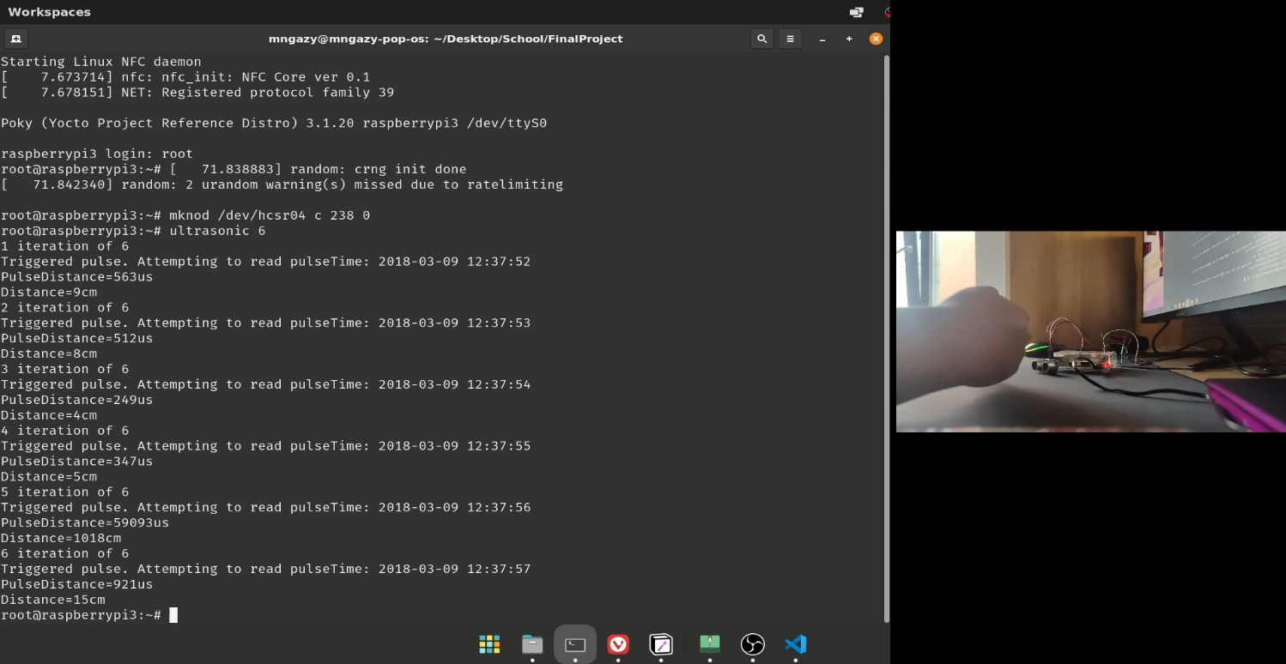
Output
Reading the ultrasonic sensor for 6 counts

Slide 17
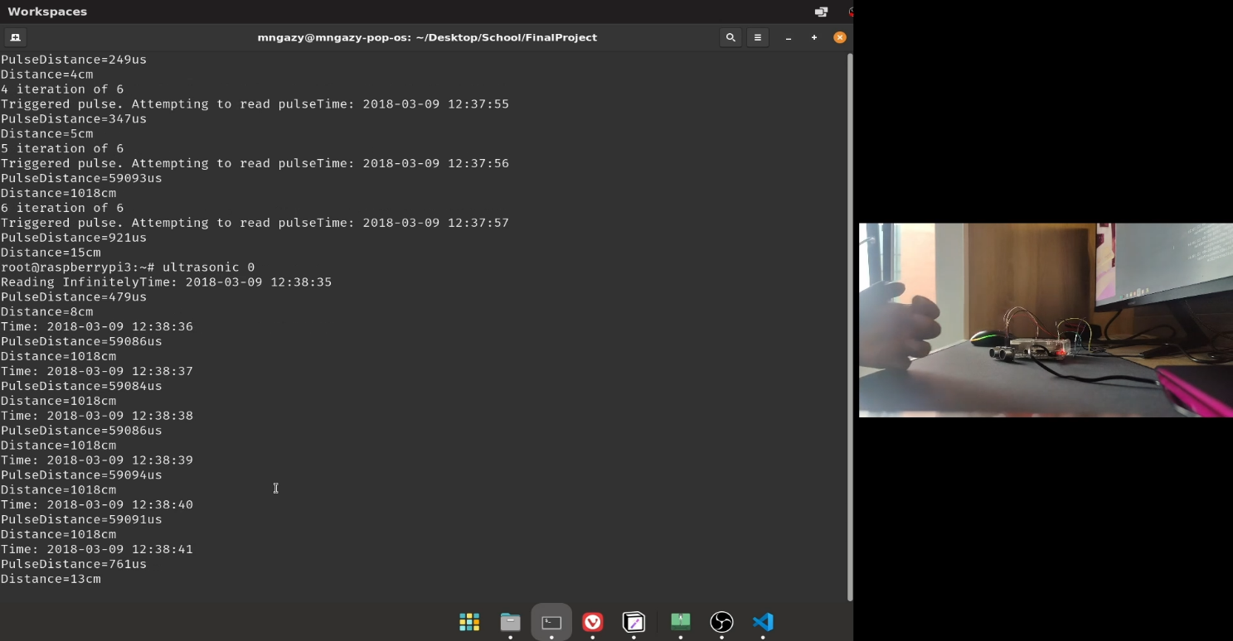
Output
Reading the ultrasonic sensor infinitely

Slide 18
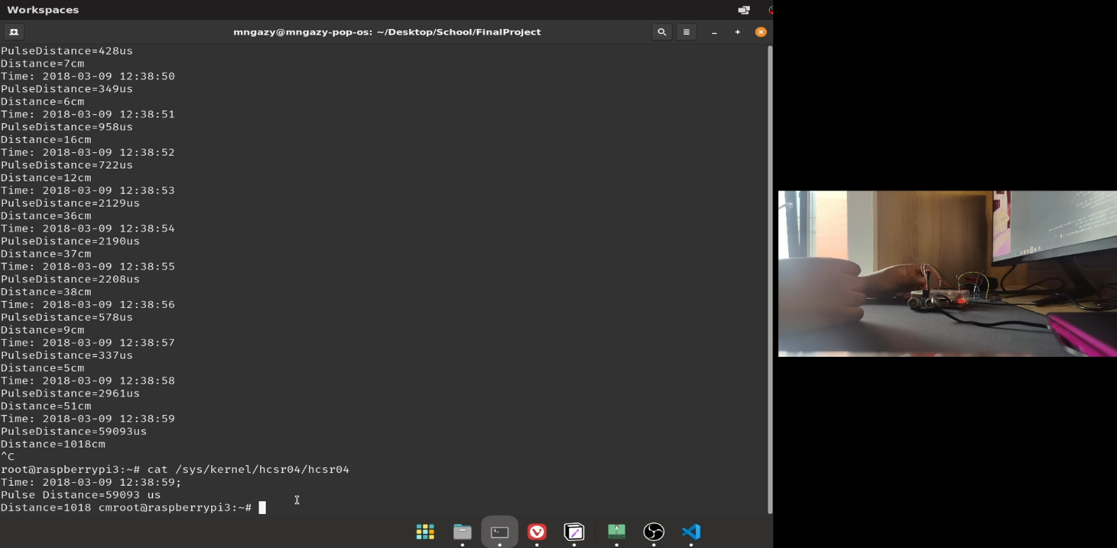
Output
Returning the last read value from the ultrasonic sensor

Slide 19
Thank You

